Slide 1
eCommerce Purchase Decisions
Alex Qaddourah, Alex McLaughlin, Teddy Li, Junji Wiener
Notes:
Need to talk about colView and colCart columns to explain the 100% accuracy either here or in report.

Slide 2
AGENDA
Business Understanding
What are the underlying factors that drives an eCommerce decision.
Data Understanding & Limitations
Collection, Familiarity, Problems, Discovery, Planning
Data Preparation
Raw data transformation
Preprocessing
Subsetting
Feature Engineering
Label Encoding
Modeling
What models did we choose?
Decision Tree
Random Forest
Linear Regression
Evaluation
What do our classifiers tell us about the data?
Deployment
What can be used for model deployment?

Slide 3
Business Understanding
1
VIEW
CART
PURCHASE

Slide 4
Addressing the Business Problem
Data-Driven Question
What actions within, and circumstances surrounding, a user session on an eCommerce website can help identify the eventual purchase decision?
Product View
Cart/Wishlist
Day or Time
Problem Definition
The average cart abandonment rate for online retailers is 67.91%. To optimize the checkout process, marketers & analysts must be familiar with actions and timelines of user sessions.
Remarketing
Sale/Promotion Timelines
Price Analysis
Motivation & Potential Benefit
A data analytics solution can illuminate characteristics of consumer groups, opportunities to change behavior, and ultimately optimize conversion.
Motivate (would-be) non-Purchasers
Retain Purchasers

Slide 5
Data Understanding & Limitations
2
Collection - Familiarity - Problems - Discovery - Planning

Slide 6
Data Understanding
Collection
Where did the data set come from?
Familiarity
What did our team do to familiarize ourselves with the data?
Problems
What problems did we run into during this exploratory phase?
42 million rows
Data integrity gap
Discovery
User_session
User_id
Product_id
Brand
Various Events
Planning
Is there opportunity to help answer our business problem?

Slide 7
Data Limitations
Limited features
Imbalanced
Large (42M rows)
Highly correlated features (view -> cart)
Data structure

Slide 8
Data Preparation
3
Making the data useable

Slide 9
Preprocessing
Null Value Handling
Subsetting
Feature Engineering
One-Hot Encoding
Multicollinearity
Scaling
Notes:
This data was relatively clean already but the first thing we dealt with was the NA values. Dropped 16 mil rows from data bc brand and category was missing. Did not seem relevant to impute those values bc we still had plenty of data. We also subsetted the data to make the data more manageable by subsetting on smartphones only. We needed to create more features given the limited number of predictors in the original dataset. We used OneHotEncoding to feature engineer several different columns based on event type with 3 levels, and manual entry of which country the smartphone brand is from, as well as some based on user_ids. One is for how many unique products each user id looked at, total views per user_id, total “cart” per user_id. The 3 event type columns proved to be a problem in predicting our models (all gave 100%) bc of multicollinearity - and either view or cart were perfect predictors of purchase. We had to remove these for this reason. Lastly, we needed to scale the data in order to fit it into our models.

Slide 10
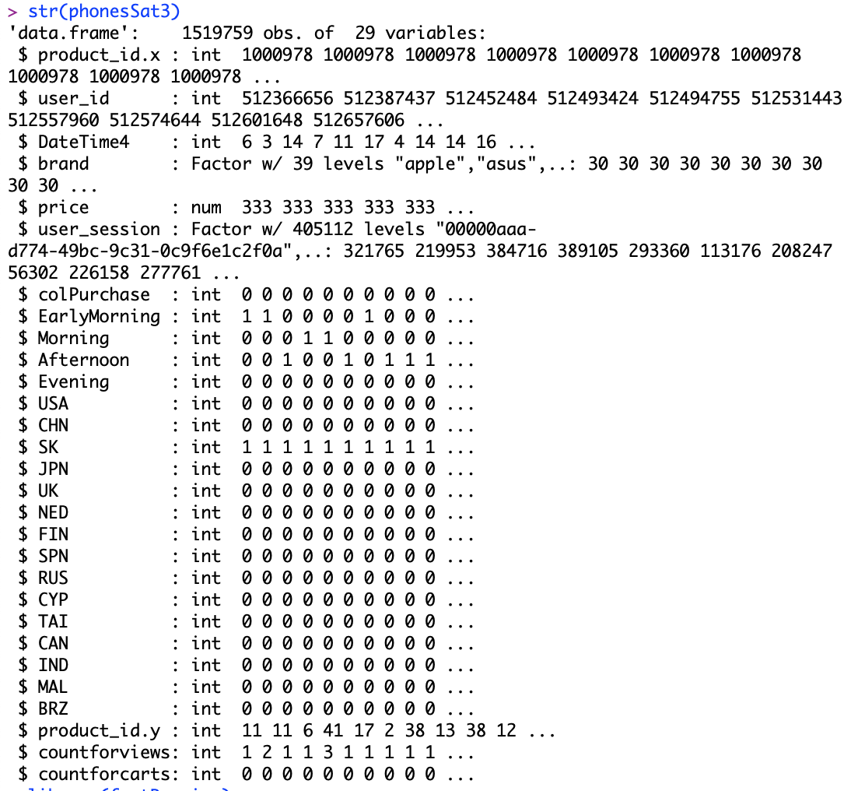

Cleaned Data Structure
Notes:
Here is our data set now. We also binned by hour of the day into Early Morning, Morning, Afternoon, Evening columns to see if that might have an effect on our predictions. Now Teddi will talk to you all about Modeling.

Slide 11
Modeling
4

Slide 12
Classifiers
Logistic Regression
Random Forest
Neural Network
XGBoost

Slide 13
Performance Metrics
Confusion Matrix
Accuracy
TPR
FPR
F1 score
Precision
ROC AUC

Slide 14
Logistic Regression
Score - 56%
Accuracy - 46%
TPR - 52%
FPR - 44%
F1 score - 54%
Precision - 57%
ROC AUC - 56%

Slide 15
Random Forest
Score - 64%
Accuracy - 38%
TPR - 53%
FPR - 62%
F1 score - 60%
Precision - 66%
ROC AUC - 70%

Slide 16
Neural Network
Accuracy - 91%
TPR - 0.12%
FPR - 0.04%
F1 score - 0.23%
Precision - 21%

Slide 17
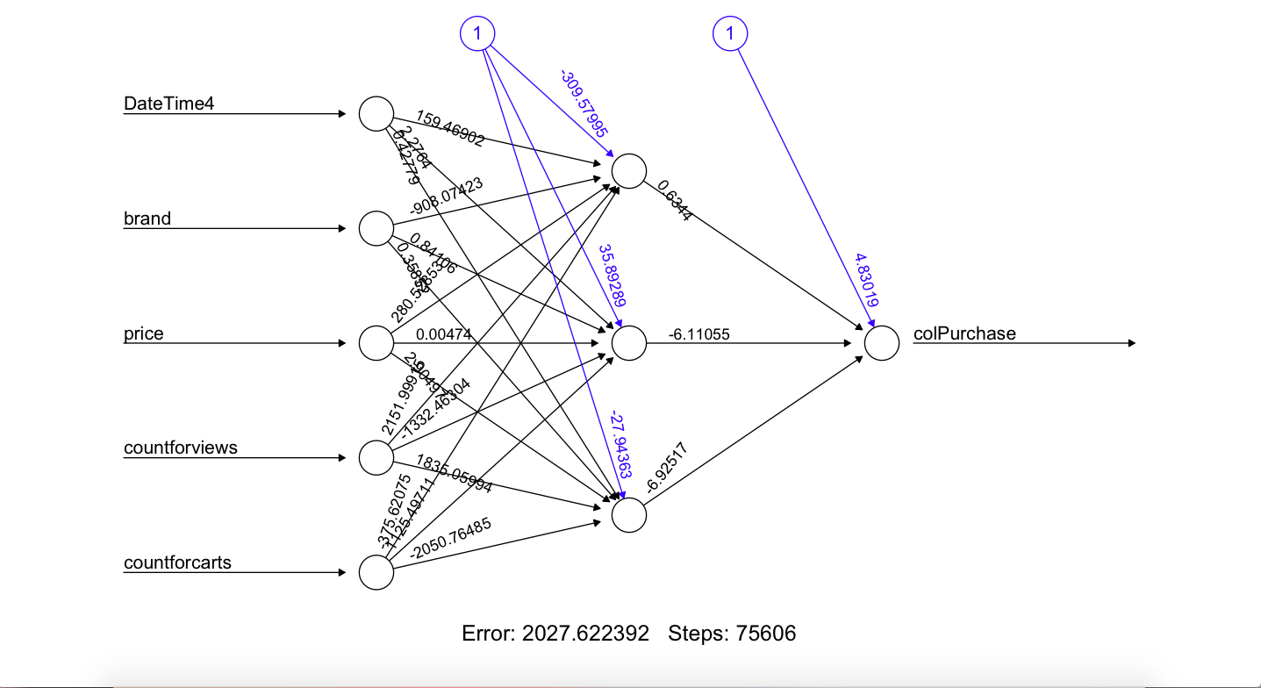
Neural Network
Neural Network

Slide 18
XGBoost
Score - 57%
Accuracy - 40%
TPR - 57%
FPR - 41%
F1 score - 58%
Precision - 59%
ROC AUC - 62%

Slide 19
Evaluation
5
What did our classifiers find?

Slide 20
Confusion Matrix
Neural Network
 | 0 | 1
0 | 1384991 | 572
1 | 134040 | 156
Random Forest Classifier
 | 1 | 0
1 | 148497 | 128850
0 | 69668 | 207211
XGBoost (upsampled)
 | 1 | 0
1 | 164157 | 113190
0 | 123354 | 153525
Logistic Regression (upsampled)
 | 1 | 0
1 | 144237 | 133110
0 | 109328 | 167551

Slide 21
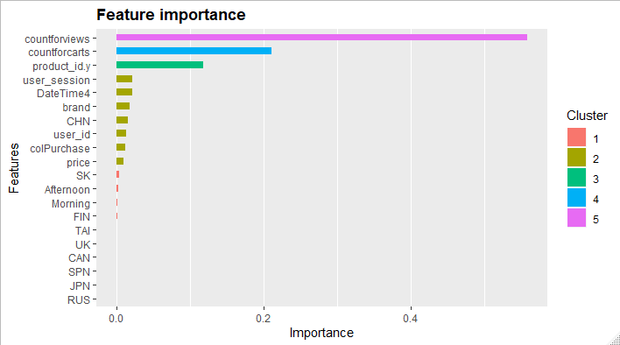
Feature Ranking
Product View Counts (total)
Cart View Counts (total)
Unique Products Viewed
User Sessions (total)
Hour of Day (24hr)
Brand
Samsung
Xiaomi
Apple
Huawei
Oppo
Meizu
Nokia
Vivo
TP-Link

Slide 22
Interpreting Models
Which model had the best F1 Score?
Random Forest
Which model had the highest Accuracy?
Neural Network (unbalanced)
Which model had the highest Precision?
Random Forest
Which model had the best TPR?
XGBoost

Slide 23
Deployment
6
Continuous Delivery for Machine Learning (CD4ML)

Slide 24
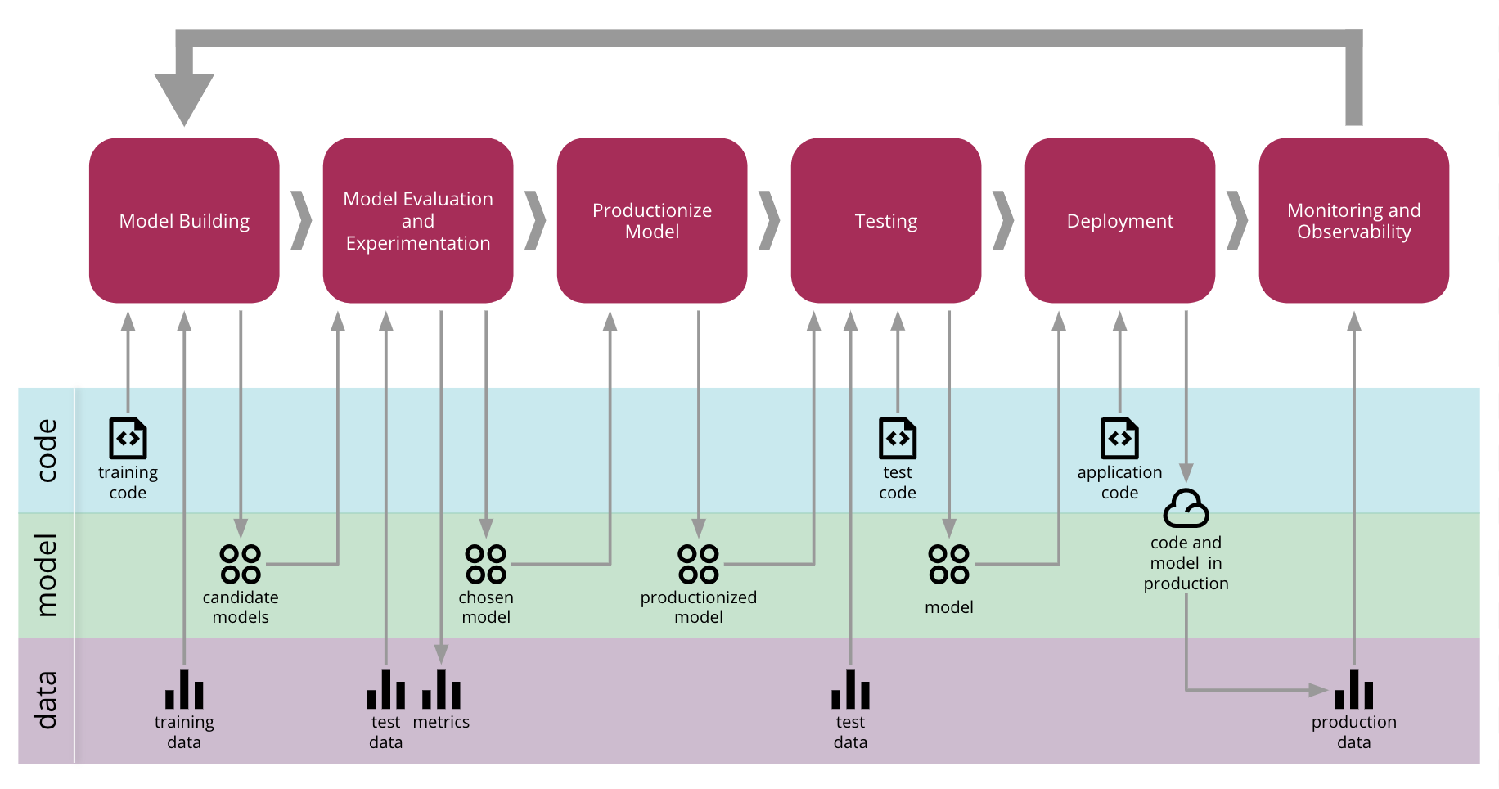
End to End Continuous Delivery for Machine Learning
Notes:
Cloud Compute engines (AWS, GCP, Azure, Heroku)
Flask API
Streaming the data

Slide 25
Thanks!
ANY QUESTIONS?
GitHub’s:
8Jun
alexqaddourah
almc6742
TeddyCU

Slide 26
Citations
Continuous Delivery for Machine Learning
https://martinfowler.com/articles/cd4ml.html#initial-ml-process.png
Danilo Sato, Arif Wider, Christoph Windheuser
Kaggle - https://www.kaggle.com/mkechinov/ecommerce-behavior-data-from-multi-category-store

